Slide 1

ELECTRIC VEHICLE ANALYSIS
- Shravan Birajdar

Slide 2


TABLE OF CONTENTS
INTRODUCTION
OBJECTIVES
PROBLEM STATEMENT
PRACTICAL EXERCISE
INSIGHTS & FINDINGS
DASHBOARD
KEY TAKEAWAYS

Slide 3

INTRODUCTION
The transition towards sustainable transportation is accelerating, highlighted by the increasing adoption of electric vehicles (EVs). This analysis delves into the dynamics of electric utilities, clean alternative fuel vehicles, battery electric (BEVs), and plug-in hybrid electric vehicles (PHEVs) across various states and cities.
We explore the diversity in EV models by year, clean alternate fuel vehicle eligibility (CAFV), the electric vehicle type and electric utility that support their integration.
BEVs, offering zero tailpipe emissions, and PHEVs, combining electric propulsion with traditional fuel, emerge as key solutions in reducing environmental impact. By examining the geographical distribution of EVs, we highlight regional trends, adoption rates, and the challenges faced in different areas.
This overview underscores the role of EVs in driving forward a cleaner, more sustainable future, showcasing the pivotal transformations in the automotive industry towards green mobility.
This Photo by Unknown Author is licensed under CC BY-NC
This Photo by Unknown Author is licensed under CC BY-NC
This Photo by Unknown Author is licensed under CC BY-NC
This Photo by Unknown Author is licensed under CC BY-NC
This Photo by Unknown Author is licensed under CC BY-NC

Slide 4

OBJECTIVES
Our analysis aims to provide a detailed examination of the burgeoning electric vehicle (EV) sector, focusing on electric utilities, and the adoption of clean alternative fuel vehicles (CAFV), including battery electric (BEVs) and plug-in hybrid electric vehicles (PHEVs).
We will investigate the distribution and proliferation of these vehicles across different states and cities, analyze trends based on model years, and evaluate their electric range capabilities. By doing so, we intend to uncover the driving forces behind EV adoption, identify existing barriers, and offer insights into the evolving landscape of sustainable urban mobility.

Slide 5

PROBLEM STATEMENT
KPI’s Requirement
Total Vehicles:
Understand the overall landscape of electric vehicles, encompassing both BEVs and PHEVs, to assess the market's size and growth.
2. Average Electric Range:
Determine the average electric range of the electric vehicles in the dataset to gauge the technological advancements and efficiency of the EVs.

Slide 6
PROBLEM STATEMENT
KPI’s Requirement
3. Total BEV Vehicles and % of Total BEV Vehicles:
Identify and analyze the total number of Battery Electric Vehicles (BEVs) in the dataset.
Calculate the percentage of BEVs relative to the total number of electric vehicles, providing insights into the dominance of fully electric models.
4. Total PHEV Vehicles and % of Total PHEV Vehicles:
Identify and analyze the total number of Plug-in Hybrid Electric Vehicles (PHEVs) in the dataset.
Calculate the percentage of PHEVs relative to the total number of electric vehicles, offering insights into the market share of plug-in hybrid models.

Slide 7


PROBLEM STATEMENT
Charts Requirement
Total Vehicles by Model Year (From 2010 Onwards):
Visualization: Line/ Area Chart
Description: This chart will illustrate the distribution of electric vehicles over the years, starting from 2010, providing insights into the growth pattern and adoption trends.
2. Total Vehicles by State:
Visualization: Map Chart
Description: This chart will showcase the geographical distribution of electric vehicles across different states, allowing for the identification of regions with higher adoption rates.

Slide 8
PROBLEM STATEMENT
Charts Requirement
3. Top 10 Total Vehicles by Make:
Visualization: Bar Chart
Description: Highlight the top 10 electric vehicle manufacturers based on the total number of vehicles, providing insights into the market dominance of specific brands.
4. Total Vehicles by CAFV Eligibility:
Visualization: Pie Chart or Donut Chart
Description: Illustrate the proportion of electric vehicles that are eligible for Clean Alternative Fuel Vehicle (CAFV) incentives, aiding in understanding the impact of incentives on vehicle adoption.
5. Top 10 Total Vehicles by Model:
Visualization: Tree map
Description: Highlight the top 10 electric vehicle models based on the total number of vehicles, offering insights into consumer preferences and popular models in the market.

Slide 9

PRACTICAL EXERCISE

Slide 10


Total Vehicles
Total Vehicles = DISTINCTCOUNT(Electric_Vehicle_Population_Data[DOL Vehicle ID])

Slide 11
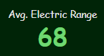
Average Electric Range
Avg. Electric Range = (AVERAGE(Electric_Vehicle_Population_Data[Electric Range))

Slide 12
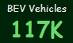
Total BEV Vehicles
BEV Vehicles = CALCULATE([Total Vehicles], Electric_Vehicle_Population_Data[Electric Vehicle Type] = "Battery Electric Vehicle (BEV)")

Slide 13

% Of Total BEV Vehicles
% Of BEV = [BEV Vehicles] / [Total Vehicles]

Slide 14
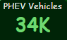
Total PHEV Vehicles
PHEV Vehicles = CALCULATE([Total Vehicles], Electric_Vehicle_Population_Data[Electric Vehicle Type] = "Plug-in Hybrid Electric Vehicle (PHEV)")

Slide 15

% Of Total PHEV Vehicles
% Of PHEV = [PHEV Vehicles] / [Total Vehicles]

Slide 16
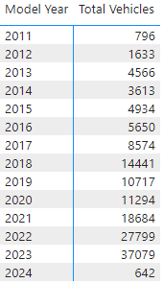
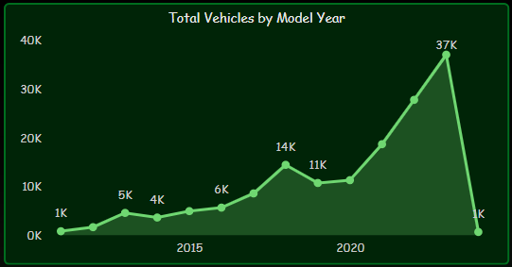
Total Vehicles by Model Year (From 2010 Onwards):

Slide 17
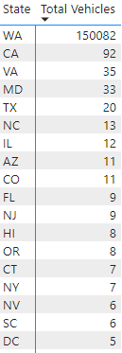
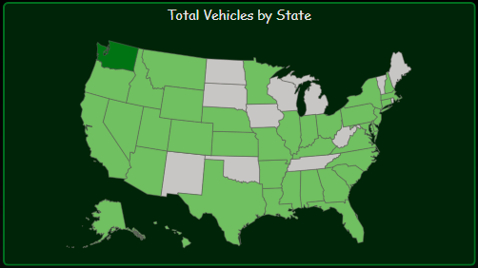
Total Vehicles by State:

Slide 18
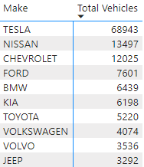
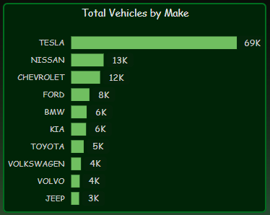
Top 10 Vehicles By Make:

Slide 19
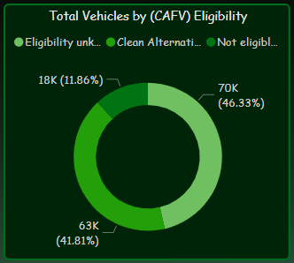
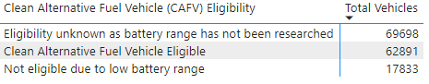
Total Vehicles by CAFV Eligibility:

Slide 20
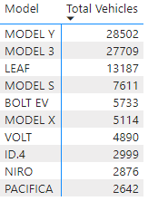
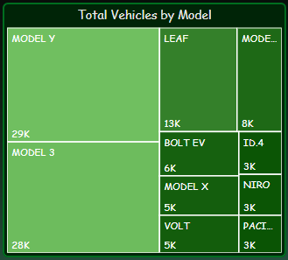
Top 10 Total Vehicles by Model:

Slide 21

INSIGHTS & FINDINGS
Average electric range is 68.
Total 37,079 vehicles manufactured in the year 2023.
Highest best selling model is “MODEL Y” and the sales is 28,502.
Washington state has maximum contribution of vehicles i.e. 1,50,082.
Highest battery electric vehicles (BEV), 1,16,529 sold in the state of Washington.

Slide 22


INSIGHTS & FINDINGS
1,50,422
Total Vehicles

Slide 23

Total Vehicles By Make
TESLA
01
NISSAN
68943
02
CHEVROLET
13497
03
FORD
12025
04
BMW
7601
05
6439
KIA
06
TOYOTA
07
6198
VOLKSWAGEN
VOLVO
08
5220
09
4074
JEEP
10
3536
3292

Slide 24
Clean Alternative Fuel Vehicle Eligibility (CAFV)
Total Vehicle Contribution | % Contribution | Clean alternative fuel vehicle eligibility (CAFV)
69,698 | 46.33 | Eligibility unknown as battery range has not been researched
62,891 | 41.81 | clean alternative fuel vehicles
17,833 | 11.86 | low battery range

Slide 25
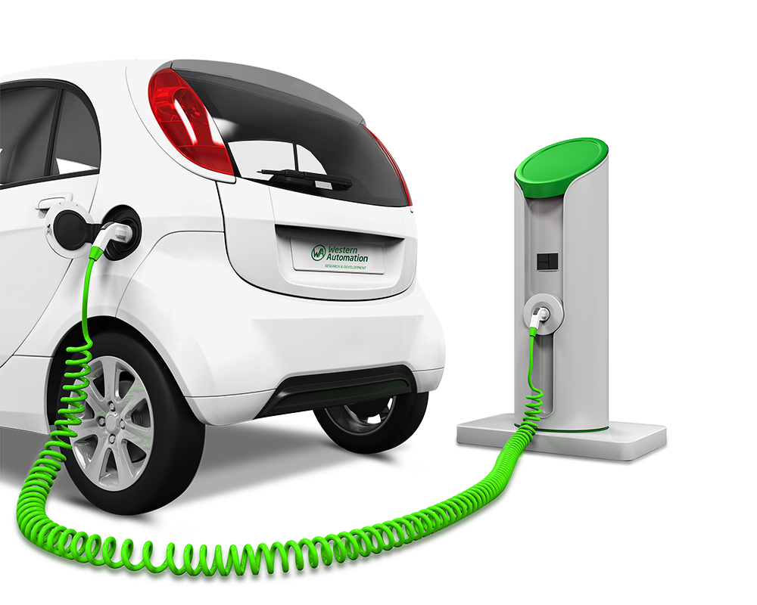
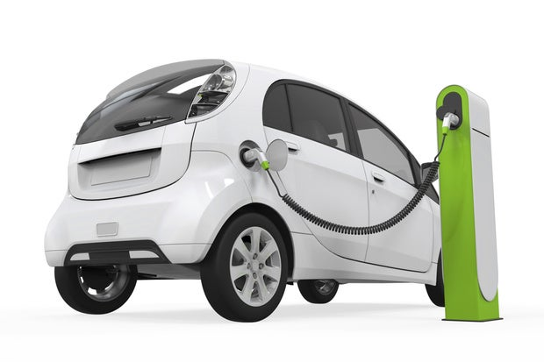

BEV & PHEV Vehicles
Total BEV Vehicles
116750
78%
Of Total BEV
22%
Total PHEV Vehicles
33672
Of Total PHEV

Slide 26



…And “The Highest Contribution Of Vehicles For The Model Year 2023 Award” Goes To…
Total vehicles manufactured by TESLA 68,943
Maximum contribution of vehicles in the model year 2023 is 17,986

Slide 27

DASHBOARD

Slide 28
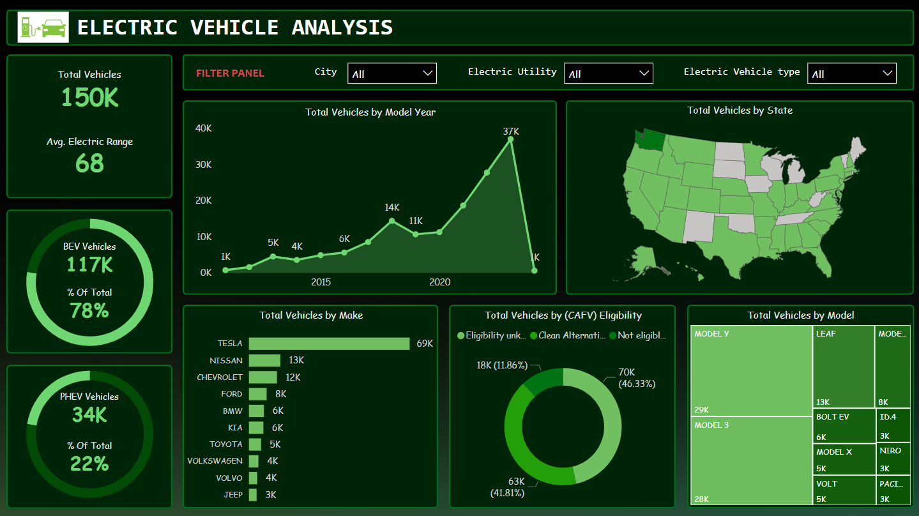

Slide 29
KEY TAKEAWAYS
𝐌𝐚𝐫𝐤𝐞𝐭 𝐀𝐧𝐚𝐥𝐲𝐬𝐢𝐬:
𝐌𝐚𝐫𝐤𝐞𝐭 𝐓𝐫𝐞𝐧𝐝𝐬: Analysis might reveal growth trends, highlighting increases in 𝐄𝐕 adoption rates, consumer preferences for specific 𝐄𝐕 models, or regions with high 𝐄𝐕 sales.
𝐒𝐞𝐠𝐦𝐞𝐧𝐭𝐚𝐭𝐢𝐨𝐧: Segmenting the market based on demographics, vehicle types, and usage patterns can uncover niche markets or areas for potential growth.
𝐄𝐧𝐯𝐢𝐫𝐨𝐧𝐦𝐞𝐧𝐭𝐚𝐥 𝐈𝐦𝐩𝐚𝐜𝐭:
𝐄𝐦𝐢𝐬𝐬𝐢𝐨𝐧 𝐑𝐞𝐝𝐮𝐜𝐭𝐢𝐨𝐧: Estimating the reduction in carbon emissions due to 𝐄𝐕 adoption helps quantify environmental benefits.
𝐄𝐧𝐞𝐫𝐠𝐲 𝐂𝐨𝐧𝐬𝐮𝐦𝐩𝐭𝐢𝐨𝐧: Analyzing energy consumption patterns of 𝐄𝐕𝐬 versus traditional vehicles can highlight the potential for renewable energy integration.
𝐒𝐭𝐫𝐚𝐭𝐞𝐠𝐢𝐜 𝐈𝐧𝐬𝐢𝐠𝐡𝐭𝐬:
𝐑𝐞𝐜𝐨𝐦𝐦𝐞𝐧𝐝𝐚𝐭𝐢𝐨𝐧𝐬 𝐟𝐨𝐫 𝐒𝐭𝐚𝐤𝐞𝐡𝐨𝐥𝐝𝐞𝐫𝐬: The analysis can inform stakeholders, including policymakers, manufacturers, and infrastructure developers, about strategic decisions like investment locations, policy incentives, or vehicle features.
𝐂𝐨𝐧𝐬𝐮𝐦𝐞𝐫 𝐁𝐞𝐡𝐚𝐯𝐢𝐨𝐫 𝐈𝐧𝐬𝐢𝐠𝐡𝐭𝐬: Understanding consumer behavior, such as preferences for 𝐄𝐕 models or charging habits, can inform marketing strategies and product development.

Slide 30





Thank You!
- Shravan Birajdar

